Slide 1
MetaPred: Meta-Learning for Clinical Risk Prediction with Limited Patient Electronic Health Records
Source: KDD ’19
Speaker: Tzu-Yun, Chien
Advisor: Jia-Ling, Koh
Date: 2020/07/22

Slide 2
OUTLINE
01
Introduction
02
Method
03
Experiment
04
Conclusion

Slide 3
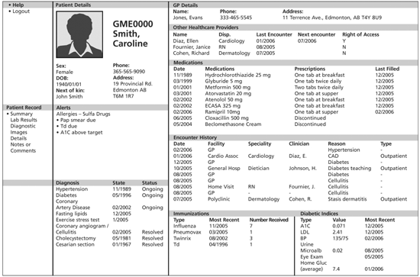
INTRODUCTION
Output :
In-hospital mortality
Hospital readmission
Chronic disease onset
Condition exacerbation
…
In this paper is to predict the onset risk
Input :
Electronic Health Records (EHR)

Slide 4
INTRODUCTION
《Hung-Yi Lee – Meta Learning ppt》
Meta Learning
(Learn to learn)
I can learn task 101 better because I learn some learning skills
Learning
task 1
Learning
task 2
…
Be a better learner
Learning
task 100

Slide 5
INTRODUCTION
《Hung-Yi Lee – Meta Learning ppt》
Meta Learning
(Learn to learn)
Task 1
Train
Test
cat
dog
cat
dog
Training
Task 2
Train
Test
apple
orange
apple
orange
Testing
Task
Train
Test
bike
car
bike
car

Slide 6
INTRODUCTION
Aim(s)
Problem:
limited patients EHRs -> insufficient to train a good predictor
Idea:
Using the learning experiences from a set of relevant tasks
Solution:
MetaPred (A meta-learning for clinical risk prediction from patient EHRs)

Slide 7
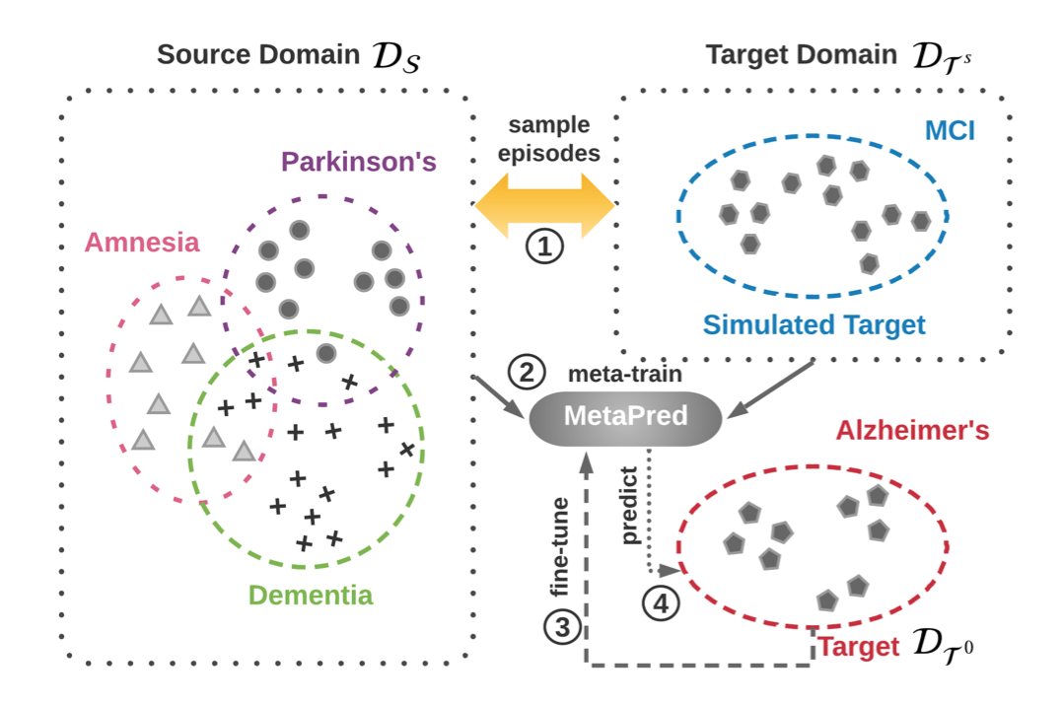
METHOD
Framework

Slide 8
METHOD
MetaPred
Goal:
Learner (risk prediction model): CNN or LSTM

Slide 9
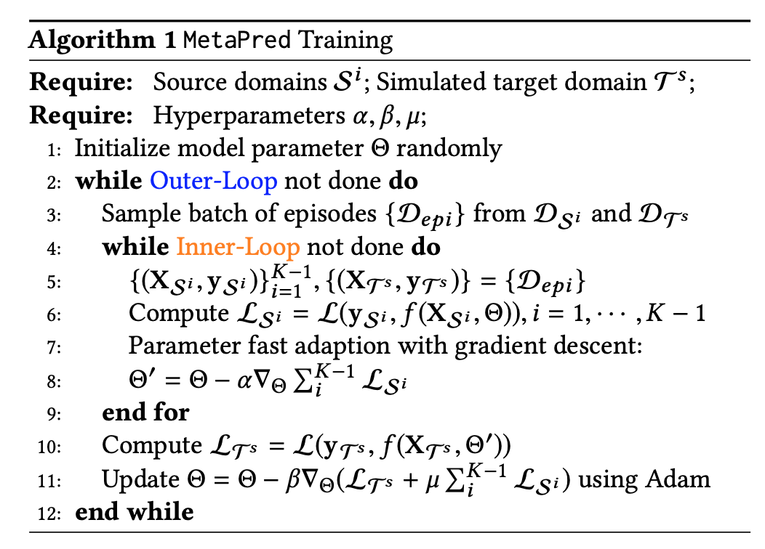
METHOD
MetaPred Training

Slide 10
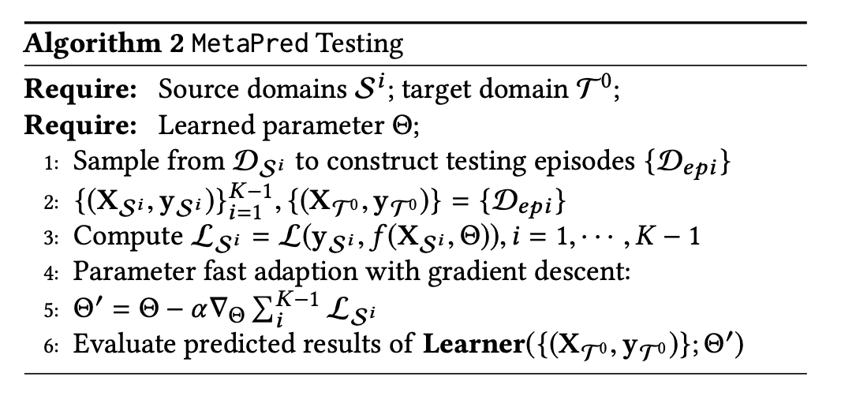
METHOD
MetaPred Testing

Slide 11
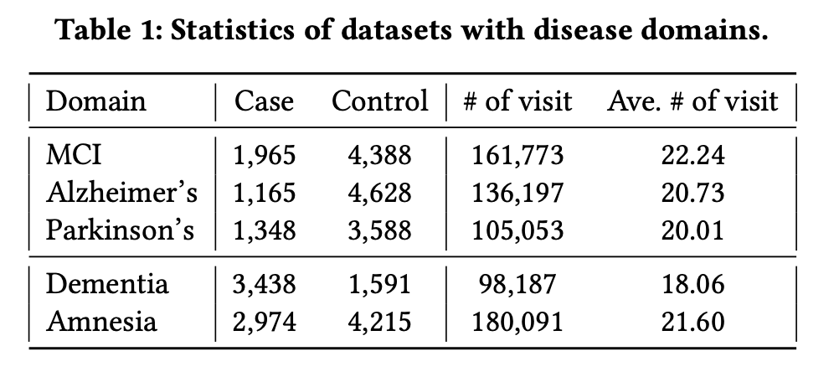
EXPERIMENT
Dataset
2-year observation ; predict half a year

Slide 12
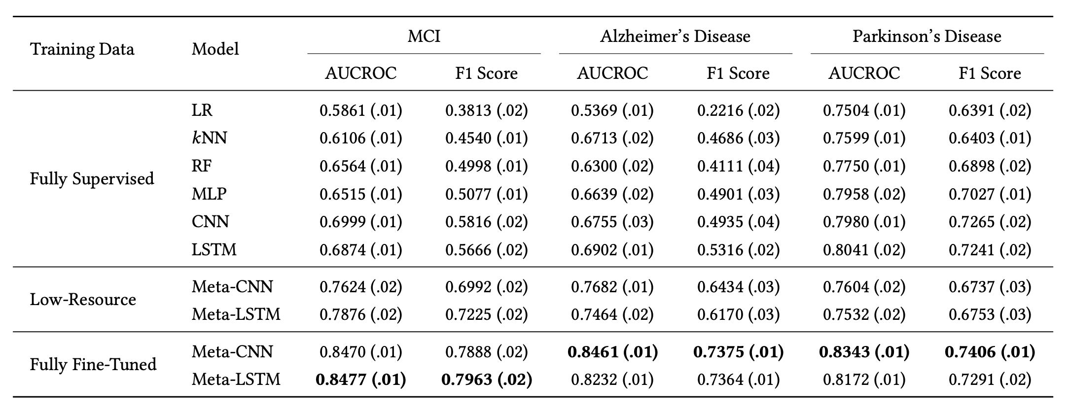
EXPERIMENT
Performance on Clinical Risk Prediction
Notes:
The simulated target are set as Alzheimer ∼ MCI, MCI ∼ Alzheimer, and MCI ∼ Parkinson (A is a simulated target and B is a target if A ∼ B).
MCI and Alzheimer are fairly difficult to be distinguished with other relevant disorders. Nevertheless, the symptoms of Parkinson’s Disease sometimes are obvious to be recognized, which makes it a relatively easier task.

Slide 13
EXPERIMENT
Comparisons of Different Resource Levels

Slide 14
EXPERIMENT
Impact of Source Domain
Notes:
Amnesia always benefits more as a source domain whereas Parkinson benefits less compared to other sources.

Slide 15
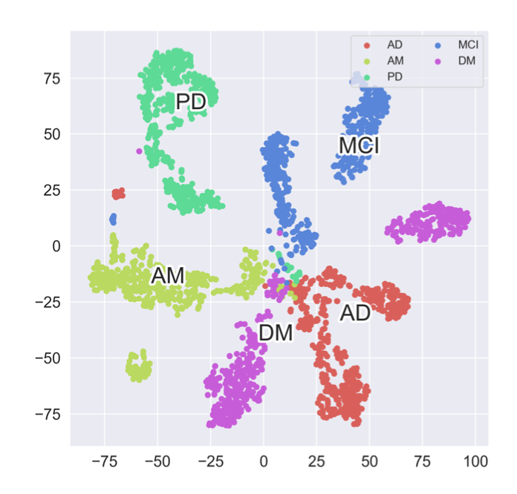
EXPERIMENT
Patient Representation in 2d Space
MCI
PD = Parkinson
AM = Amnesia
DM = Dementia
AD = Alzheimer

Slide 16
Conclusion
Propose an effective framework MetaPred that can solve the low-resource medical records problem in clinical risk prediction
Introduce a objective-level adaptation for MetaPred

